Slide 4
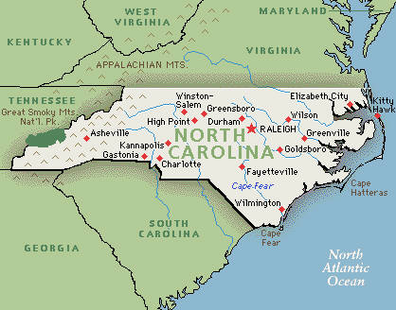
Division Within North Carolina
Albemarle
Cape Fear

Slide 5
No Capital???
No permanent capital
Lawmakers met wherever the Governor lived
Records were rolled from places to place
North and South complained whenever the governor moved outside their area

Slide 6
Granville District
When the Proprietors sold back their property to King Charles, all of them did, except for John Carteret, Earl Granville. His parcel of land included a 60 mile strip across Carolina, this became the Granville District.

Slide 7
Conflict and Chaos
1
Conflict between northern and southern counties was about unequal representation.
2
They raised quitrents in the north to equal those in the south.
Governor Johnston passed these laws by holding an Assembly meeting when bad weather prevented the Albemarle delegates from attending.
3
People in Albemarle refused to follow the laws because they felt that the southern counties had passed them unfairly, at a meeting that did not have a quorum.
What does this lead to?

Slide 8
Anarchy The complete absence of government, including law enforcement

Slide 9
What is Anarchy in the 1700’s

Slide 10
Albemarle in revolt
The people of Albemarle called the Assembly a fraud and protested. They withdrew from the Assembly and even threatened to withdraw from the colony. For seven years, the north lived in anarchy, a complete absence of government. People refused to follow laws or pay taxes. The southern counties also refused to pay taxes.

Slide 11
Reunion of North and South
When Governor Johnston died;
Arthur Dobbs: became governor in 1752 and the Albemarle counties once again sent five representatives each to the Assembly.

Slide 12
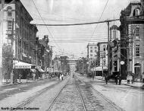
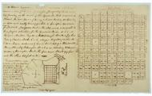
WHY IS RALEIGH OUR CAPITAL TODAY?
The city of Raleigh was purchased and created for the purpose of being the state’s capital
Names Raleigh after Walter Raleigh, explorer
Purchased 1,000 acres of land from Joel Lane
March 30, 1792 it was official

Slide 14
Division between West and East
Back country
(poor)
Coastal
(rich)

Slide 15
New Governor in town
Rise of
William Tryon after the death of Arthur Dobbs.

Slide 16
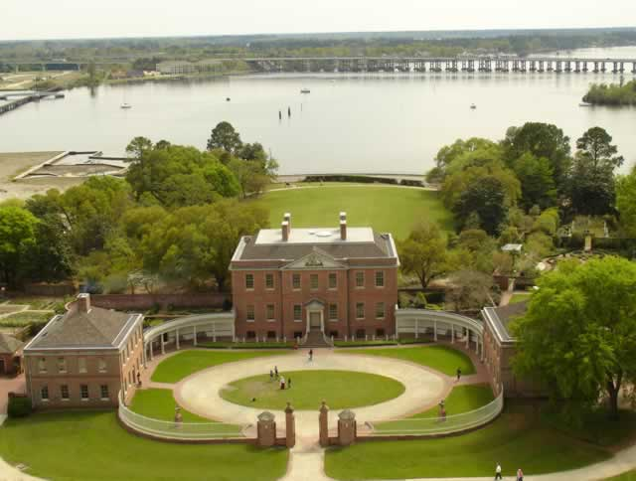
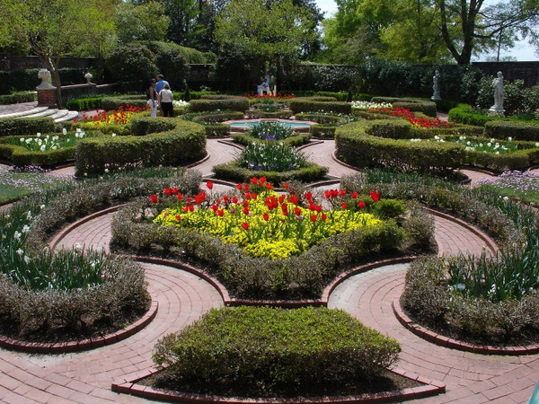
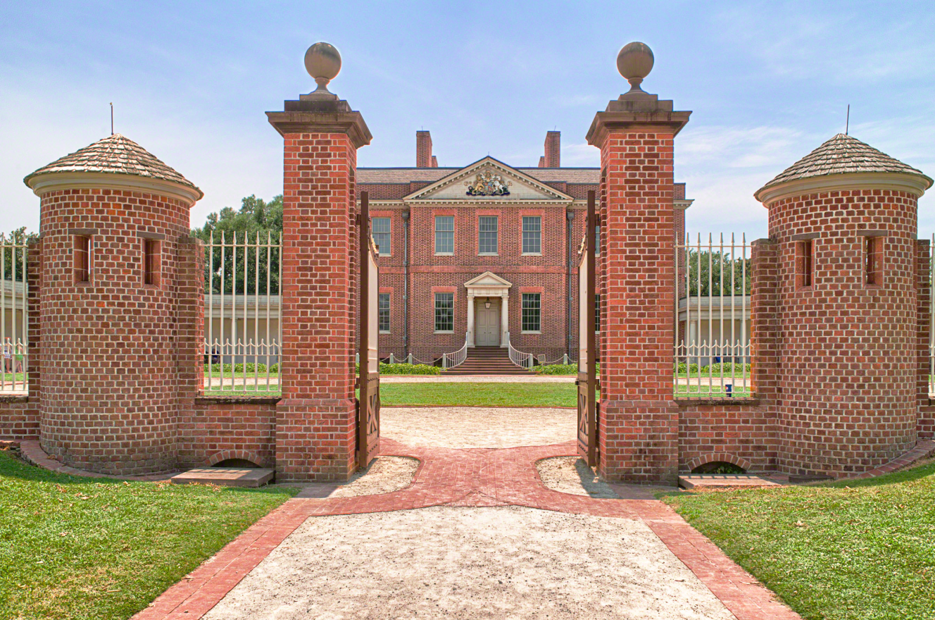
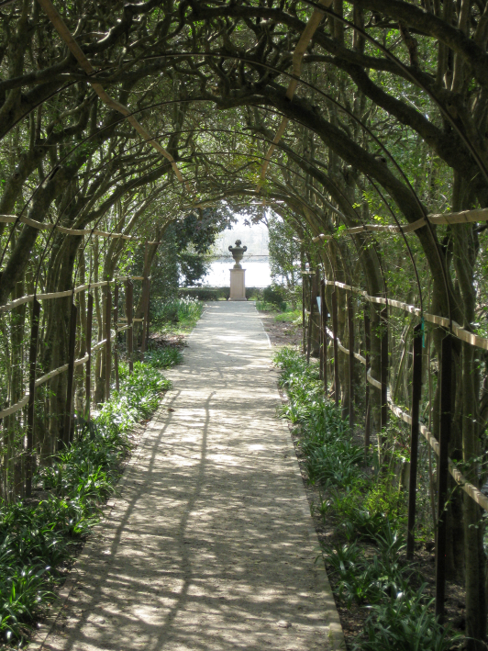
TRYON PALACE

Slide 17
Tryon Palace
Brick building trimmed in marble
Assembly called it “truly elegant and noble.”
Angered Westerners
“Not one man in twenty…will ever see this famous house when built.”

Slide 18
THE EAST
Mostly English
Enjoyed the comforts of civilized life
Nice homes
Furniture
Imported Clothing
Small group of wealthy planters and merchants
Enslaved and indentured labor

Slide 19
THE WEST
Mostly Scots-Irish and Germans
Simple, small farmers with isolated land
Lived in log cabins
Operated life on a barter economy

Slide 20
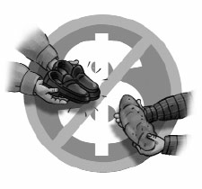
barter system
an exchange of goods and services; this was used instead of specie (gold) in the back country
Western counties were still developing its people struggling and still used the barter system

Slide 21
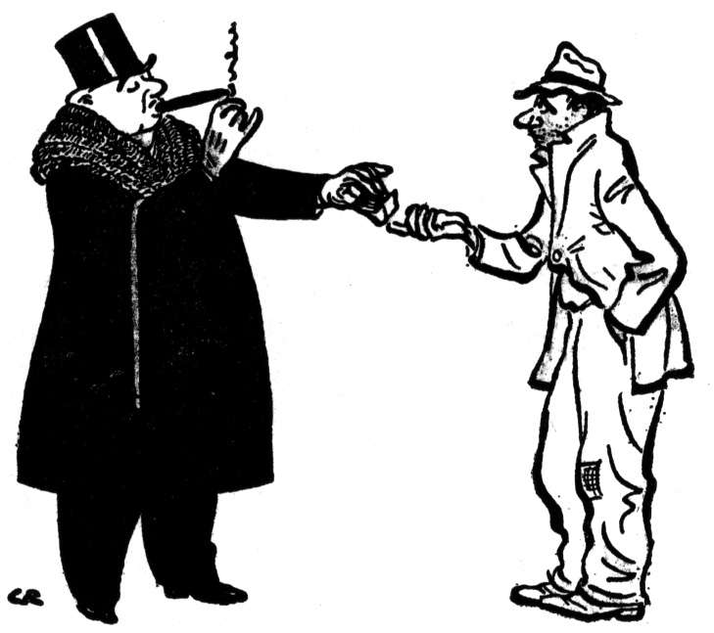
Why does this matter?
Easterners:
Superior Attitudes
Believe in the Social Order
Competition
Westerners:
Self-reliant
Democratic
See all people as equals

Slide 22
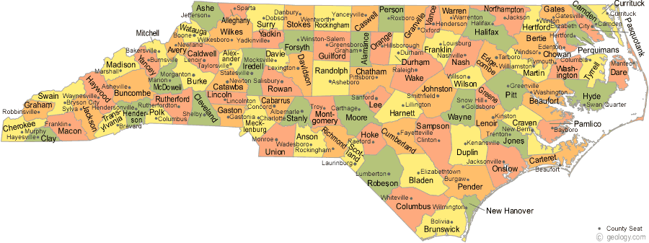
Unequal Representation
Representation in the Assembly was by county (NOT population)
While the population grew in the backcountry, they had to create more counties
To maintain control, the rich Easterners created more counties in the East whenever it created new western counties

Slide 23
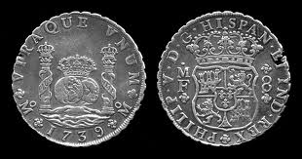
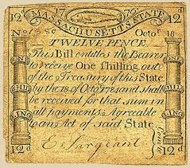
Corrupt Officials
Officials charged higher fees than allowed
Backcountry had a lack of money
Taxes/fees had to be paid in currency
If you could not come up with the right currency, your land would be taken and auctioned off

Slide 24
Tipping Point
A poll tax to pay for the governor’s new palace
Taxed each person, poor or rich, the same rate
Seemed unfair to the poor farmers of the West
“We are determined not to pay the Tax for the next three years, for the…Governor’s House. We want no such house.”

Slide 27
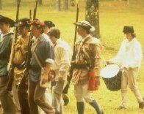
Regulator
a member of a western group created to prevent abuses of power

Slide 28
Edmund Fanning was the focus of the tension between east and west.
Fanning represented everything westerners despised
To his equal, he was charming; to the westerners, he was “cruel and domineering.
Fanning accused the Regulators of rioting.

Slide 29
When Fanning First To Orange Came
When Fanning first to Orange came,
He looked both pale and wan:
An old patched coat was on his back,
An old mare he rode on.
Both man and mare weren’t worth five pounds,
As I’ve been often told;
But by his civil robberies,
He’s laced his cat with gold

Slide 30
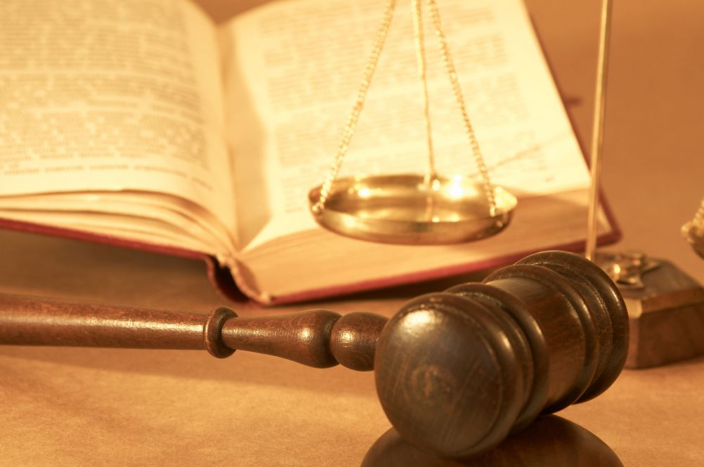
Guilty of Extortion
The Regulators accused Fanning of extortion.
Even though he was found guilty, he was given no punishment
Governor Tryon upheld the decision, and the Regulators grew furious!

Slide 31
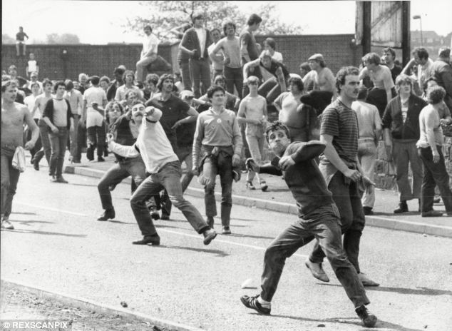
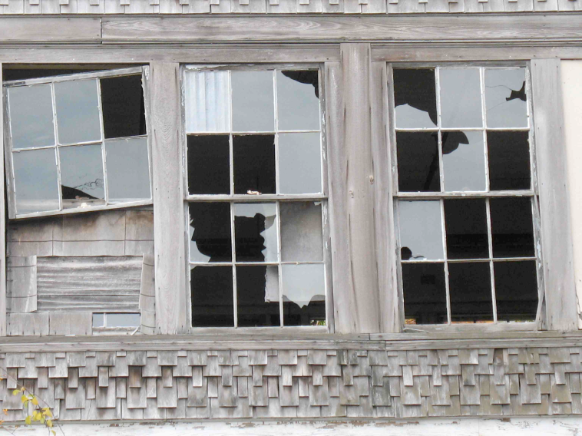
Hillsborough Riot
September 1770
150 Regulators broke into the courthouse
Drove the judge from the bench
Dragged Fanning down the courthouse steps by his heels
Whipped Fanning, looted his home, and smashed windows throughout the town

Slide 32
Governor Tryon tells the Regulators to take a hike!

Slide 33
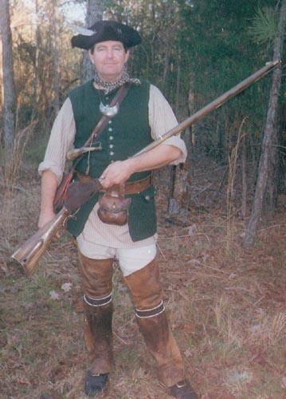
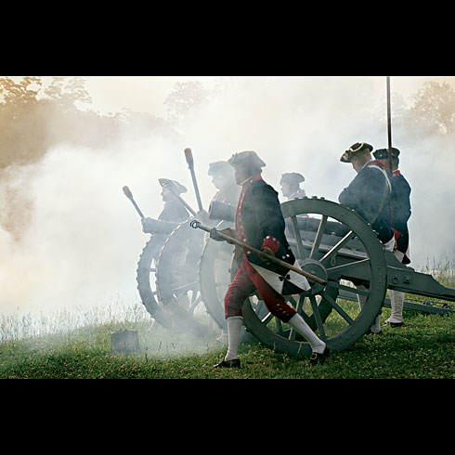
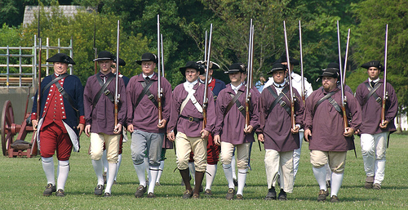
William Tryon heard this and decided to prevent them from marching to New Bern.
The farmers were poorly organized but willing to risk their lives.
The Governor called on the trained Militia, mostly Highland Scots, to put down this tax rebellion.

Slide 34
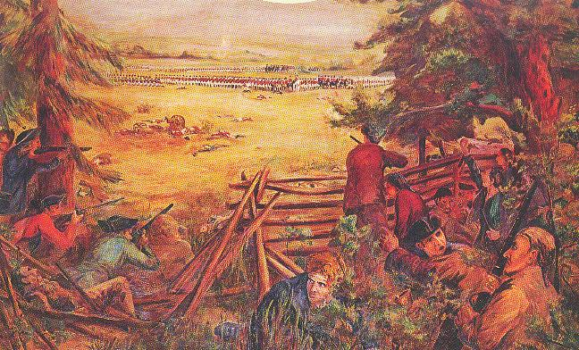
Battle of Alamance 1771
fight between Tryon’s troops and the Regulators

Slide 35
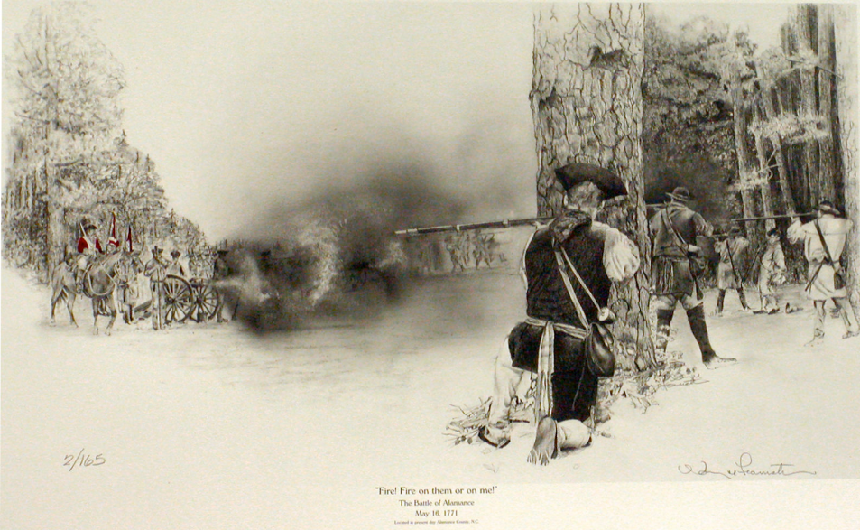
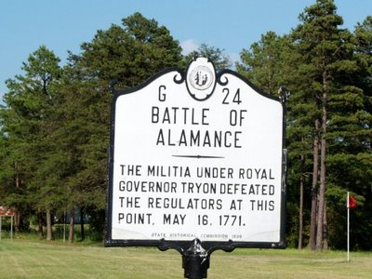
Battle of Alamance
Tryon demanded that the Regulators lay down their arms
Regulators said, “Fire and be damned!”
Battle raged for two hours until Tryon’s forces won out

Slide 36
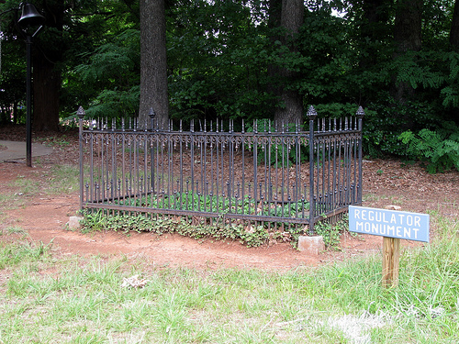
Battle of Alamance; Outcome
Governor Tryon’s forces beat the Regulators in the Battle of Alamance in 1771; thousands were pardoned in exchange for allegiance to the colonial government.

Slide 37
How do you think North Carolina history might have been different if the Regulators had won the battle of Alamance?

