Slide 1
The African American Struggle in the 20th Century
Life After Reconstruction 1877-1940’s
The Civil Rights Movement 1950’s and 1960’s

Slide 2
Changes to the Constitution empower African Americans in the 1860s.
13th Amendment ends slavery
14th Amendment gives full citizenship to any person born in the U.S.
This allowed former slaves to automatically become citizens if they were simply born in the U.S.
15th Amendment gives African American men the right to vote

Slide 3
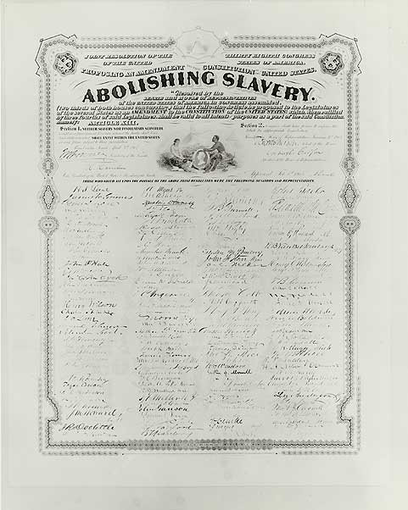

Slide 4
How did the South respond to the changes to the Constitution?
Plessy Vs. Ferguson (1896)
U.S. Supreme Court decides that segregation is legal
Says it is okay to be separate as long as everything is equal.
Jim Crow laws
Laws passed by southern state governments that segregated people by race
Separated by race in restaurants, hotels, water fountains, barber shops etc.
Separated by race in the military
Separated by race in schools
No marriage with other races

Slide 5
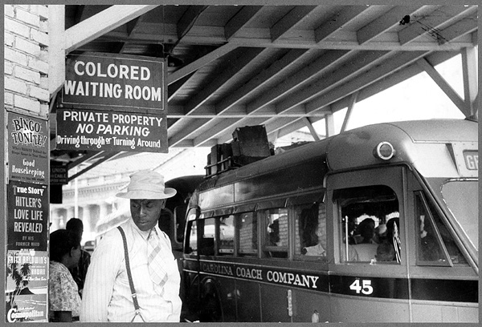
Life under Jim Crow Laws

Slide 6
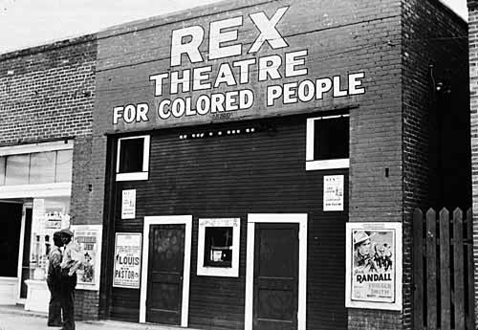
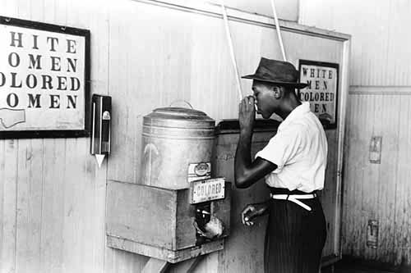

Slide 7
How did Southern governments respond to the changes to the Constitution?
Poll Tax
This was a tax that people had to pay in order to vote
This kept poor people from voting
How much money do you think a newly freed slave had?
What about poor white people?
A “Grandfather clause” allowed people to vote without paying the poll tax if…
Their father or grandfather had been allowed to vote
Basically white people did not have to pay the poll tax

Slide 8
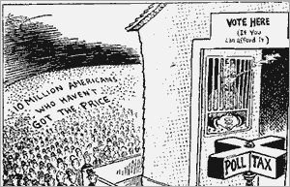
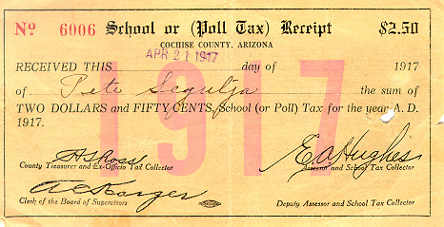
Poll Tax

Slide 9
How did Southern governments respond to the changes to the Constitution?
Literacy test
This was a reading test that had to be passed before you were allowed to vote
Because slaves had not been allowed to receive an education, many could not vote
Again, because of the “Grandfather clause,” white people did not have to take this test

Slide 10
How did racist people in the South respond to the changes to the Constitution?
Intimidation
KKK threatens African Americans who vote and any white people who help them
Widespread lynchings in the South

Slide 11
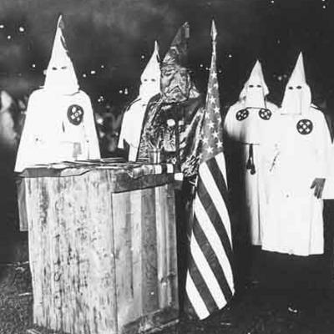
The Ku Klux Klan

Slide 12
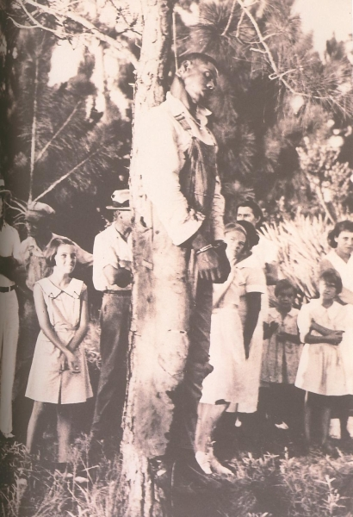
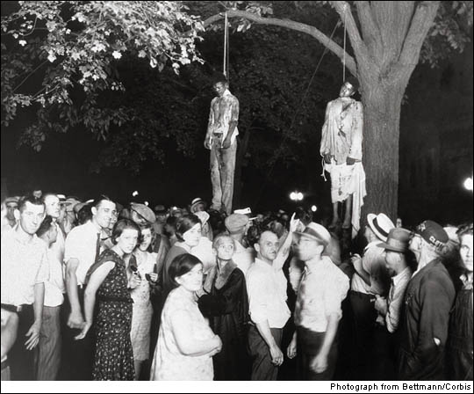
Lynchings in the South

Slide 13
So, what was the effect of all of this on African Americans?
They were treated like second class citizens.
Many could not vote.
If they could vote, many did not because they feared for the safety of their families.
They had no power in the Government
Forced into poverty and limited in education
A feeling of inferiority and powerlessness
This same situation lasted from the Civil War in the 1860’s until the Civil Rights Movement in the 1950’s and 1960’s (100 Years!!!!)

Slide 14
We Deserve Better!!!
World War I and World War II occurred during the Jim Crow time period of segregation
In both wars, African American men fought bravely, although in segregated regiments
When they returned to the U.S., they demanded equal rights

Slide 15
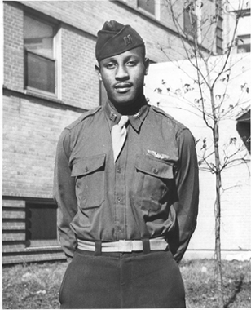
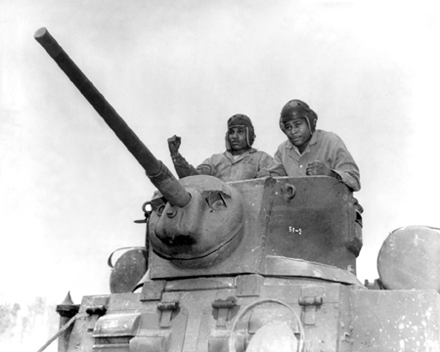
African American men served in both World War I and World War II

Slide 16
The Civil Rights Movement
A movement of African Americans in which they fought for equal rights and equal treatment under the law.
Led by great African American leaders and organizations that fought against the injustice of the “Jim Crow” United States

Slide 17
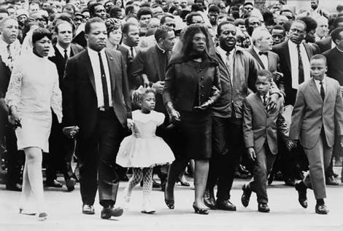
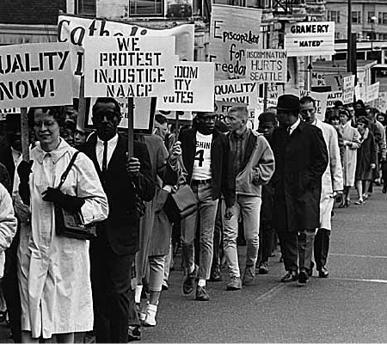

Slide 18
NAACP
National Association for the Advancement of Colored People founded in 1909
Organization that stood up for the rights of African Americans
Sets up the Legal Defense Fund (LDF) to pursue equality using talented lawyers arguing in the courts

Slide 19
Brown vs. Board of Education
This was a supreme court case in 1954
Lawyers from the NAACP argued that segregation was illegal because the schools for African Americans were not equal to schools for white students.
The U.S. Supreme Court agreed.
Segregation in schools became illegal

Slide 20
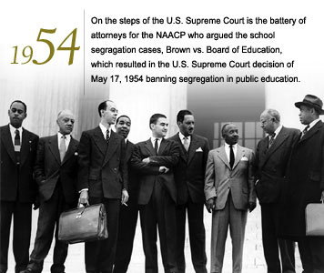
NAACP and Brown vs. Board

Slide 21
Brown vs. Board moves slowly
The Supreme Court said that Southern states should end segregation “with all deliberate speed.”
By not setting an exact date, it allowed Southern states to basically ignore the court.
Whites in the South riot when a black woman is admitted in the University of Alabama
Little Rock 9- 1957: Black students at Central High School in Little Rock, Arkansas are mobbed when they try to attend a white school. They have to be protected by the National Guard

Slide 22
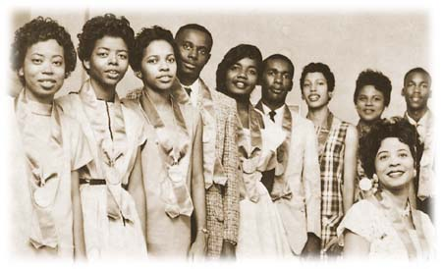
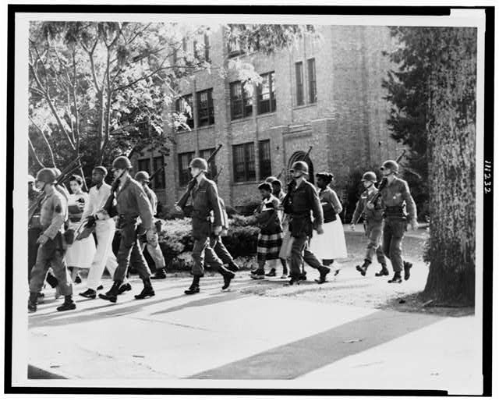
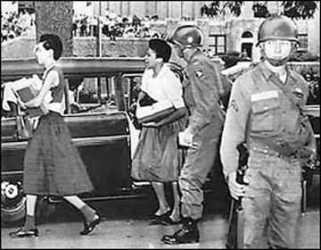
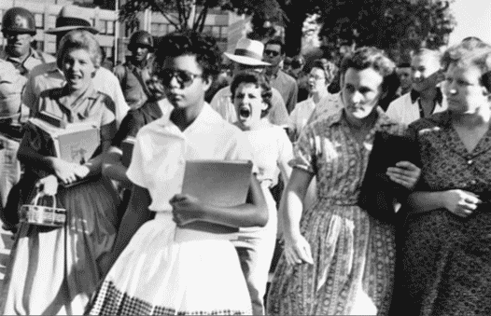
Desegregation of Schools in 1957

Slide 23
Bus Boycott
Montgomery, Alabama 1955
Rosa Parks challenges segregation on public buses
A young minister named Martin Luther King Jr. is chosen to lead a boycott of the bus system
After a year, the boycott is successful and the buses are desegregated

Slide 24
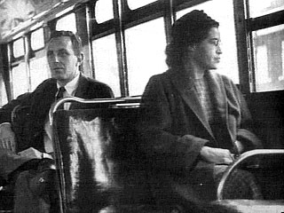
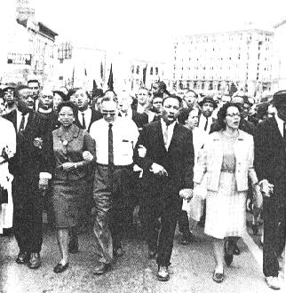
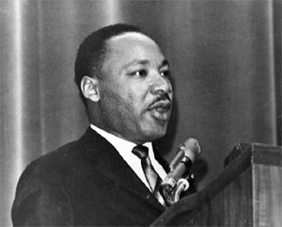
Bus Boycott: Montgomery, Alabama 1955

Slide 25
Non-Violent Protest
Martin Luther King Jr. advocated for using non-violence to forcing social change.
Modeled this approach after Gandhi’s struggle against the English in India.
Basically he believed that to achieve a goal as pure as racial equality, one must purify his/her own soul first.
That means
No violence
Accepting the consequences: beatings, dogs, jail, fire hoses etc.
All the while, make sure that the media can watch, take pictures, and videotape so that the whole world can see what is really going on.

Slide 26
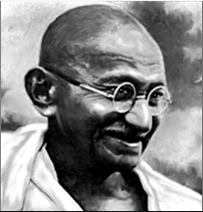
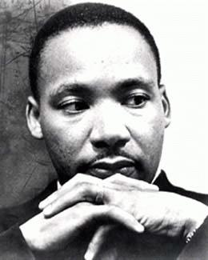
Nonviolent Protest was and is an international phenomenon.
Gandhi stressed nonviolence as he led India’s resistance to British oppression in the 1940’s

Slide 27
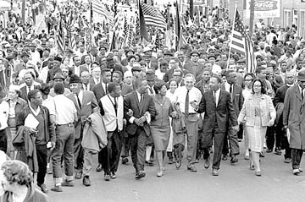
Examples of Non-Violent Protest
Boycotts
Sit-ins
Marches
“Freedom Rides”
Litigation (lawyers arguing cases in court)
Speeches
Newspaper editorials and articles

Slide 28
Sit-ins
Form of non-violent protest in which African Americans would go into all white restaurants and sit.
In 1960, 4 students from NC A&T sat in a Woolworths, in Greensboro, NC
They were not served, but remained in their seats until the restaurant closed.
This inspired many others (White and Black) to do the same at all white businesses across NC (Raleigh, Durham, Winston Salem, Charlotte) and the rest of the South.
Some whites along with the KKK began threatening the protesters, calling in bomb threats
Businesses started closing down to avoid the bad publicity

Slide 29
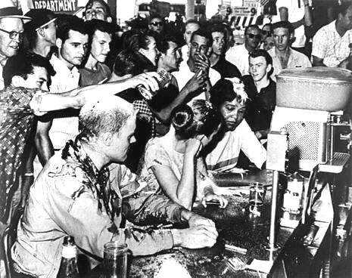
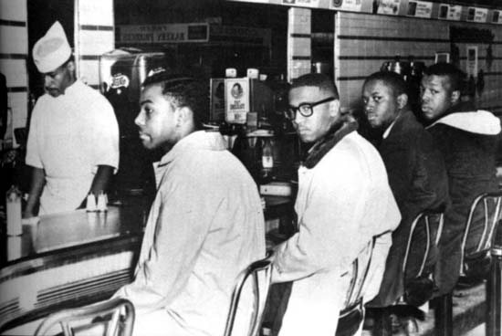
Greensboro Sit-In 1960

Slide 30
Freedom Rides
Groups of black and white civil rights protesters from the North used this non-violent way of ending segregation at bus stations in the South in May 1961
Basically, whites used black facilities and blacks used white facilities. (water fountains, bathrooms etc.)
When they arrived in Southern states they met a lot of resistance.
They were attacked in Alabama by white mobs.
Attacks continued, but the media coverage did as well.
Finally the government started sending police escorts with the freedom rides.
On Nov. 1st 1961, segregation of bus and railroad stations was made illegal

Slide 31
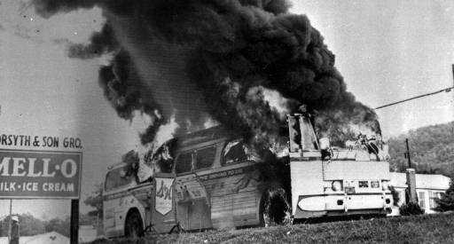
A Freedom Ride meets its end in Alabama
The Congress of Racial Equality (CORE) set out to test the newly established interstate desegregation laws on transportation. An integrated group of Freedom Riders got as far as Anniston, Alabama where they were beaten, and the Greyhound bus was burned on May 4, 1961.

Slide 32
The Struggle heats up
1962- James Meredith arrived to take classes at the all-white University of Mississippi- white riots broke out, put down by the army
April 1963- Martin Luther King Jr. is arrested after a protest march in Birmingham, AL
May 1963- More marches in Birmingham, AL
Police Commissioner “Bull” Connor orders the police to use attack dogs against them as well as fire hoses.
This is all seen on TV

Slide 33
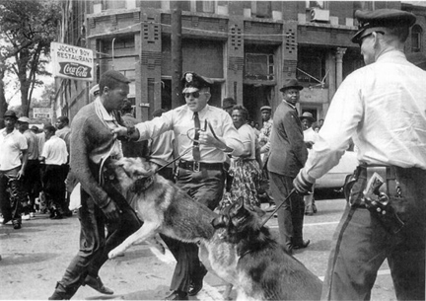
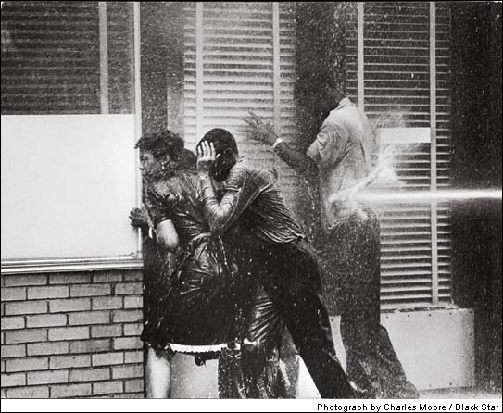
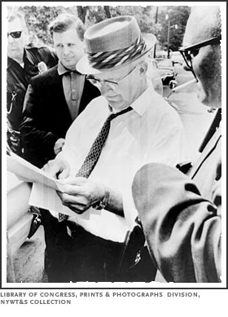
Birmingham, Alabama 1963

Slide 34
March on Washington
August 28th, 1963 250,000 people gather at Lincoln Memorial in Washington D.C. in support of Civil Rights
Martin Luther King Jr. delivers his “I Have A Dream” speech

Slide 35
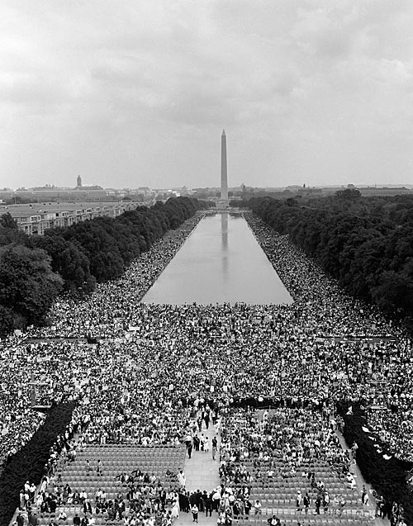
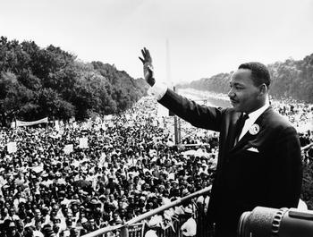
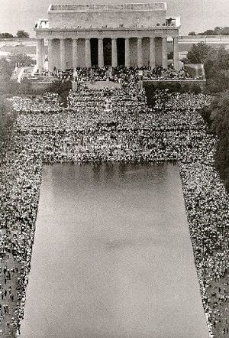

Slide 36
Four Little Girls
September 15th 1963
Birmingham, Alabama
An African American Baptist Church was bombed.
4 little girls were killed, 20 injured
The church had been a Civil Rights meeting place

Slide 37
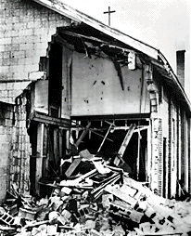
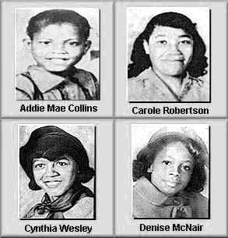
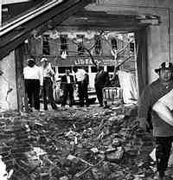
The KKK bombed the Sixteenth Street Baptist Church in Birmingham, AL in 1963 Killing these 4 girls

Slide 38
Civil Rights Act of 1964
This was a law passed by the U.S. Congress due to pressure put on by the Civil Rights movement
Made segregation illegal in all public places, like restaurants, stores, parks, etc.

Slide 39
Voting Rights
Freedom Summer, 1964
White college students traveled to Mississippi to register African Americans to vote
June 21st 1964- 3 “Freedom Summer” volunteers (2 white, 1 black) disappeared. They were found in August shot to death
Martin Luther King Jr. organizes a voter registration march in Alabama from Selma to Montgomery, 1965
Many marchers were beaten and jailed by police
Again, it was seen on TV
1965- Voting Rights Act is passed
Happened because of pressure put on by the Civil Rights Movement
It gave the U.S. government the power to inspect the voter registration procedures in Southern states
Made poll taxes and literacy tests illegal

Slide 40
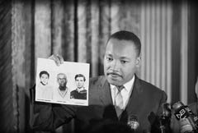
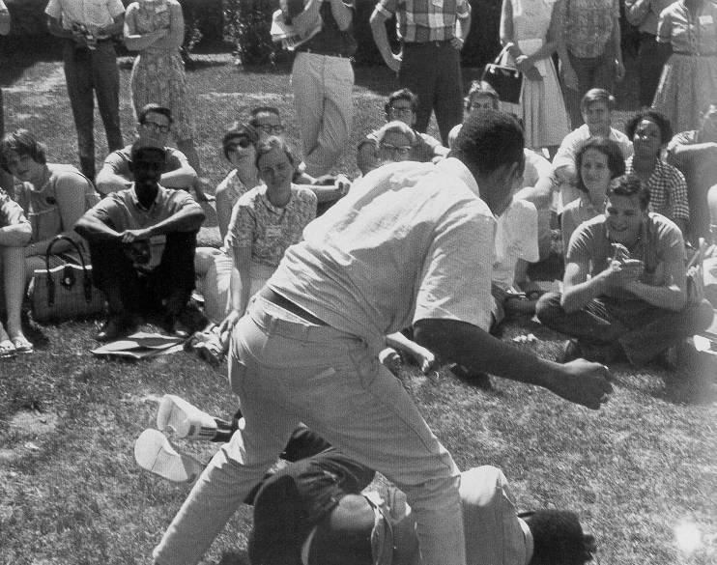
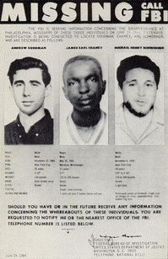
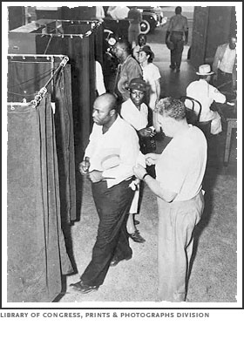
Freedom Summer in Mississippi, 1964

Slide 41
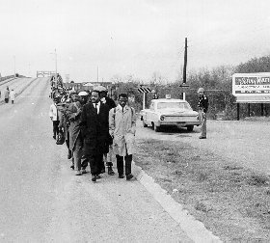
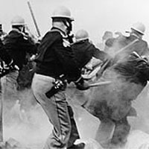
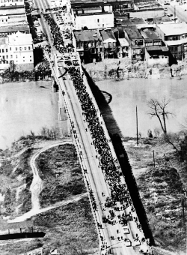
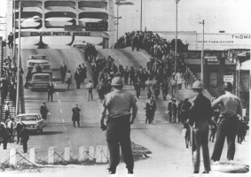
Selma to Montgomery, Alabama Voter Registration March, 1965. The Police attacked the marchers with clubs and tear gas.

Slide 42
Black Power
Despite the work of non-violent protesters, African Americans were still victims of discrimination, still poor, still intimidated.
Many started to turn to other leaders, with a more radical message
Groups like the Nation of Islam and the Black Panthers favored using “any means necessary” to improve the situation of African Americans

Slide 43
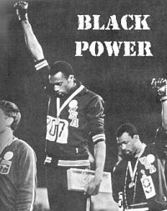
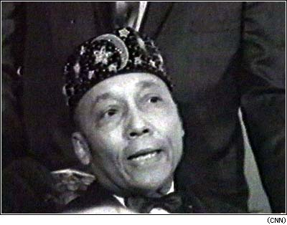
Black Power
African American Olympic medal winners giving the Black Power salute
The Nation of Islam, led by Elijah Muhammad believed in a total separation of Black and White America with African Americans having their own country.

Slide 44
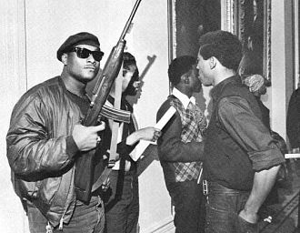
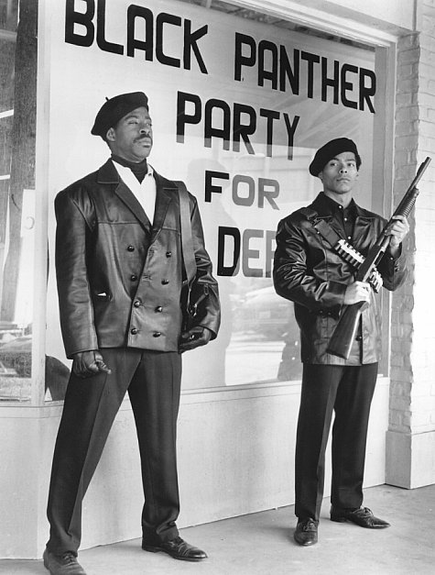
Black Panthers
They wanted to protect blacks from police harassment and brutality. To this end, they advocated arming black people with weapons and using them when necessary to defend themselves.

Slide 45
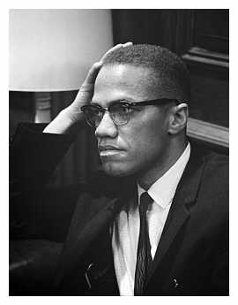
Malcolm X
A leader of the Nation of Islam
Incredible speaker, very controversial
Believed African Americans needed to fully accept their African roots before they could ever be free.
He eventually broke away from the Nation of Islam and some of its members killed him in 1965.
Saw the Civil Rights Movement in the U.S. as part of a larger, global Human Rights Movement (Africa, Middle East, Latin America)

Slide 46
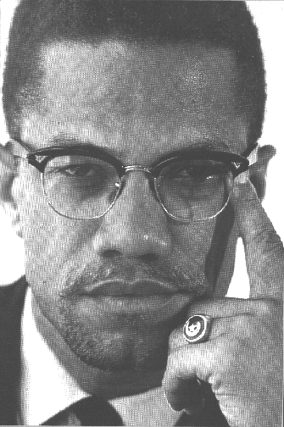
Malcolm X

Slide 47
Riots
Riots break out in Los Angeles, killing 34 people in August, 1965
More riots spread across U.S. cities
This had been predicted by Malcolm X

Slide 48
Riots broke out in Los Angeles in the summer of 1965

Slide 49
Kerner Commission
The Kerner Commission is set up by the U.S. government to investigate the causes of the violence
Found that anger over racism was the main cause
Warned that “ the Nation is rapidly moving toward two increasingly separate Americas”- one white and wealthy, the other African American and poor

Slide 50
King is Assassinated
April 4th, 1968
Memphis, Tennessee
Shot by James Earl Ray on his hotel balcony
Riots broke out in more than 100 cities in the U.S.

Slide 51
The Struggle continues
The Civil Rights Movement continues today as African Americans still struggle for full equality and against racism.
The legacy of the Civil Rights Movement was apparent last year in the use of Non-violent protests in the U.S. Were you paying attention?
Next year, there will be a Presidential Election in this country. What does it have to do with the Civil Rights Movement?

Slide 52
-Many groups of people have learned from the Civil Rights Movement. -May 1st, 2006 Latino Immigrants march peacefully for equal human rights

Slide 53
Would this have been possible without the Civil Rights Movement?
-Barack Obama hopes to run for President in 2008 representing the Democratic Party.

Slide 54
Questions to Ponder
In what ways was the Civil Rights Movement successful?
What Laws were passed because of the Civil Rights Movement? What did the laws say?
What problems do African Americans still face today?
What lessons from the Civil Rights Movement should we never forget?
What does this have to do with you?

