Slide 2
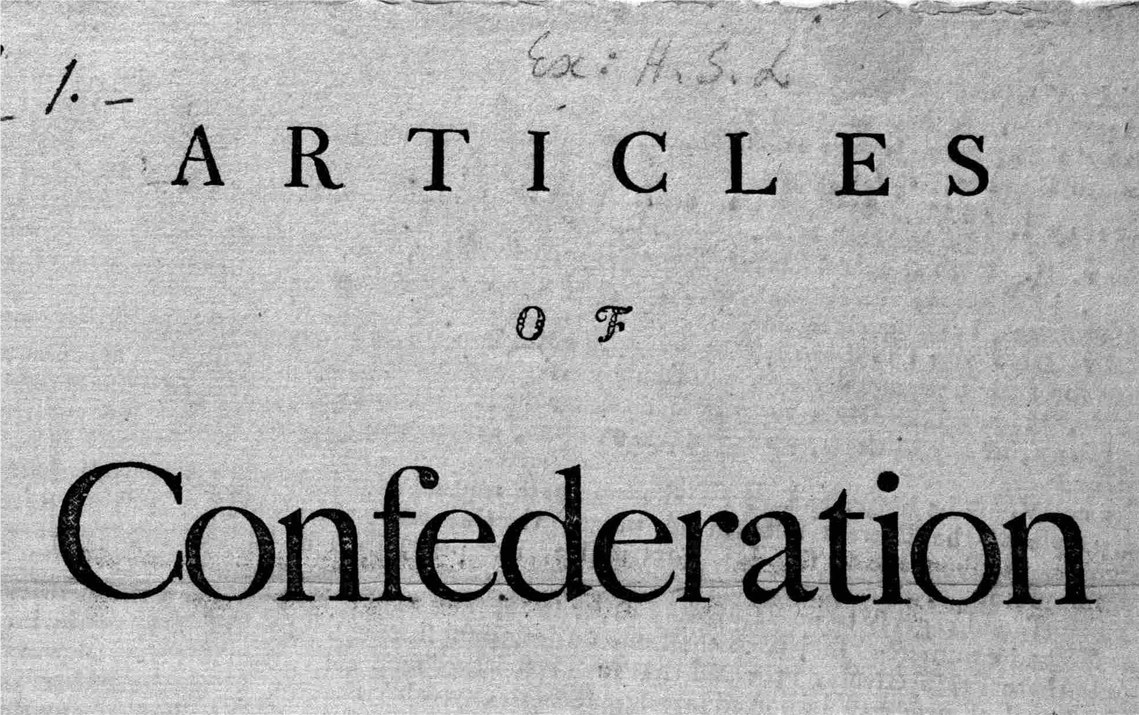

Slide 3
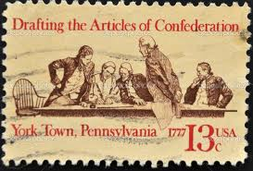
Articles of Confederation
This was our 1st National Government
1 House (unicameral) legislature (congress)
Each state would have only 1 vote
9 states to pass a law

Slide 4
The only way to amend (change) the constitution was to have all states agree
There was no leader of our country
There were no courts or jails
The national government could not tax

Slide 5
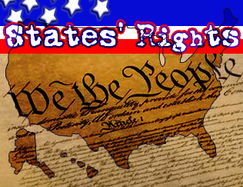
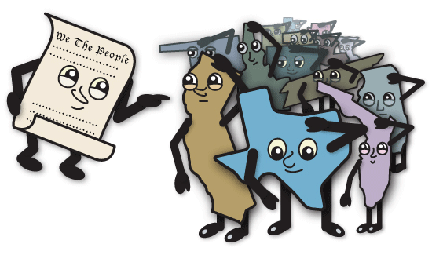
States Rights
This created a system where the states were more powerful than the country
This idea is called states rights
… this only lasted 6 years

Slide 6
So What went wrong?
Fold your paper in half. Label the columns:
Name: Articles of Confederation NOTES
Articles of Confederation
Problems
How would you fix it?
You will end up with 8 at the end of the slideshow!

Slide 7
The Articles of Confederation
Confederation = an alliance of states with a common purpose or goal.
1. Was a loose alliance of independent states- gave some power to the central government but the states kept the greater part of the power. (States Rights)
-The colonists fears of a strong central government.

Slide 8
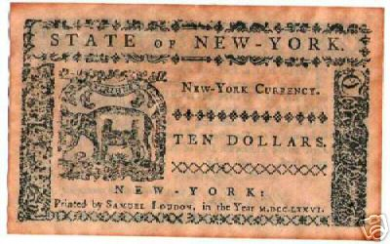
Why did the Articles of Confederation fail?
Currency Issues
The United States did not have a common currency.
Americans carried money from the federal government, state government, and foreign nations.

Slide 9
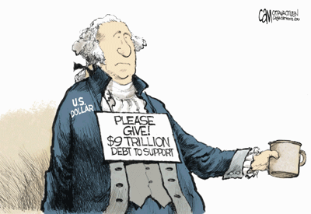
Why did the Articles of Confederation fail?
Debt
Congress could not tax the people and depended on money from the states.
Therefore, the U.S. was unable to pay its debts!

Slide 10
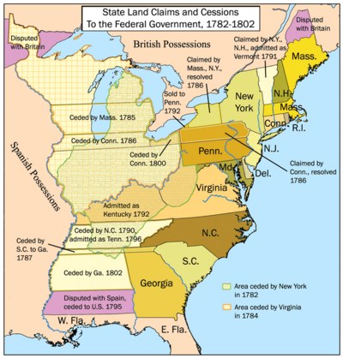
Why did the Articles of Confederation fail?
4. International and Domestic Problems
The U.S. lacked the military power to defend itself against Great Britain and Spain.
States acted as individual countries and seldom agreed.

Slide 11
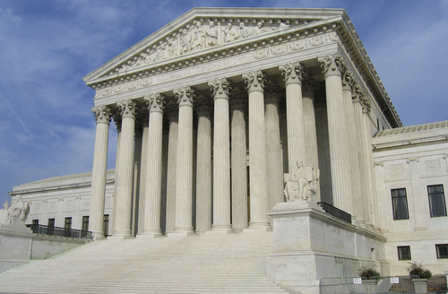
Why did the Articles of Confederation fail?
Courts (Judicial Branch)
The nation lacked a national court system.
Supreme Court

Slide 12
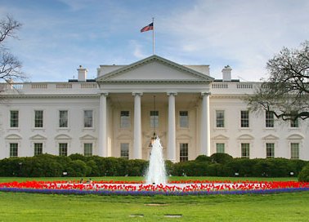
Why did the Articles of Confederation fail?
President (Executive Branch)
The nation did not have a President, or Chief Executive.
White House

Slide 13
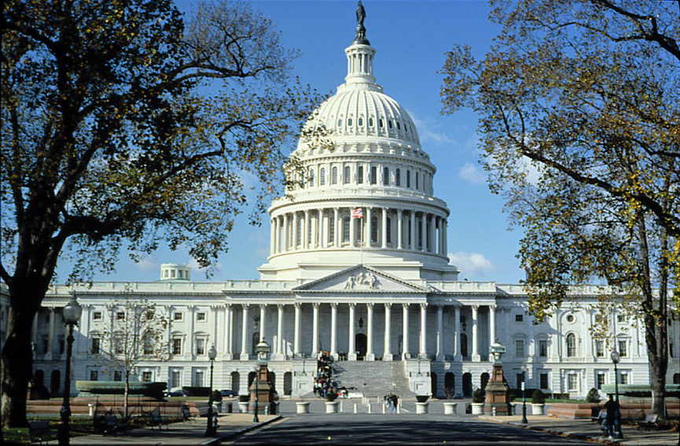
Why did the Articles of Confederation fail?
Congress (Legislative Branch)
Congress had one house. (unicameral) Took all states to amend the government.
Capitol Building
8. Laws were difficult to pass, needing the approval of nine states.

Slide 14
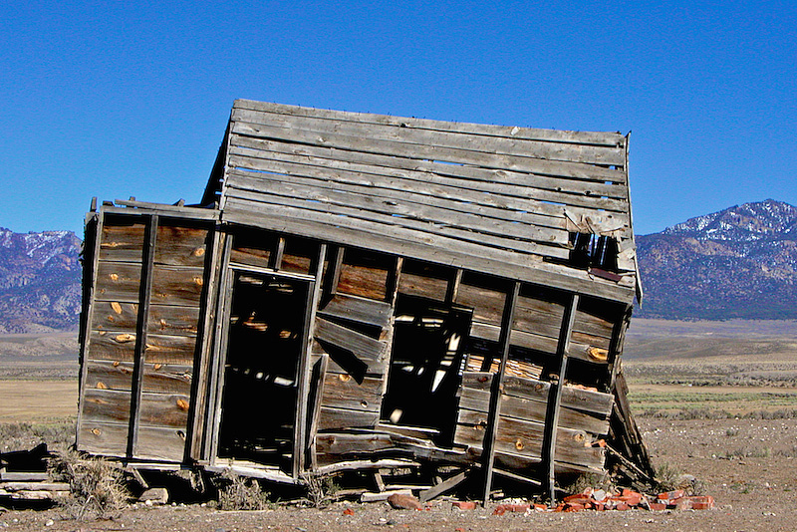
So how would you fix this type of government?
Where do you start?... Look over the problems and address those issues first. Then think about what other items may be missing. (voting rights, education, slavery, immigration, etc.)

Slide 15
Articles of Confederation Notes
Fold your paper in half. Label the columns:
Name: Articles of Confederation NOTES
Articles of Confederation How would you fix it?
Was a loose alliance of independent states- gave some power to the central government but the states kept the greater part of the power. (States Rights)
The United States did not have a common currency
Congress could not tax the people and depended on money from the states.
The U.S. lacked the military power to defend itself
The nation lacked a national court system
The nation did not have a President
Congress had one house. (unicameral)
Laws were difficult to pass, needing the approval of nine states.

